Slide 1
Competence Center Microsoft: Corso .NET BASE (BSL - Application, Product Development & Testing)
Novembre 2014

Slide 2
Struttura del corso
Contenuti
Visual Studio 2013 Intro
HTML5 (base)
CSS3 / ResponsiveDesign
Canvas
WebSocket / WebWorker
JavaScript & Ajax
jQuery (base)
WebForms (cenni)
6 Days
4h on Teaching Room (15:30-19:30)
Breaks: 16:30-17:00
Sala 203
martedì 18 novembre 2014 | 15.30 -> 19.30
giovedì 20 novembre 2014 | 15.30 -> 19.30
martedì 25 novembre 2014 | 15.30 -> 19.30
giovedì 27 novembre 2014 | 15.30 -> 19.30
martedì 2 dicembre 2014 | 15.30 -> 19.30
giovedì 4 dicembre 2014 | 15.30 -> 19.30

Slide 3

Struttura del corso
Contenuti
Visual Studio 2013 Intro
HTML5 (base)
CSS3
Canvas
WebSocket / WebWorker
Twitter Bootstrap (as example)
JavaScript & Ajax
jQuery (base)
WebForms (cenni)
6 Days
Lavoro a casa (2-4h)
Esercizi
Ripasso Lettura tutorial / documentazione
TheQuestionmark TM ‘?’ Quarter ad ogni inizio lezione
Materiali del corso
http://gioorgi.com/series/netbase
http://www.microsoftvirtualacademy.com/training-courses/learn-html5-with-javascript-css3-jumpstart-training
@Home
Hands On !!

Slide 4
Conosciamoci Meglio
NTT Data
75.000 Employes Worldwide
2.500 ca in Italia
Vocazione: System Integrator
Giovanni Giorgi Classe 1974
From 1993 on line.
Worked in the past 17 years for banking and finance
Known Programming Languages:
C#, C/C++, Erlang, Lisp, Python,SQL, Ruby, Tcl/tk, Java, SmallTalk, ObjectiveC....
Known databases:
Oracle, SQL Server, Sybase, DB2, MySql, MariaDB, MongoDB, Redis..
What about you?

Slide 5
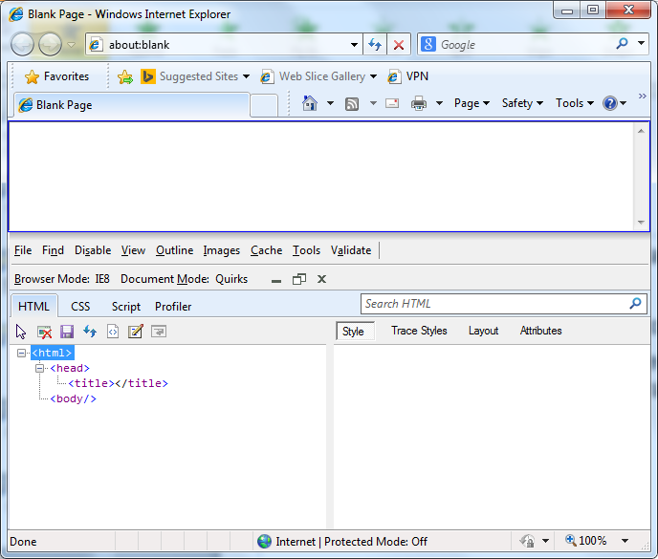
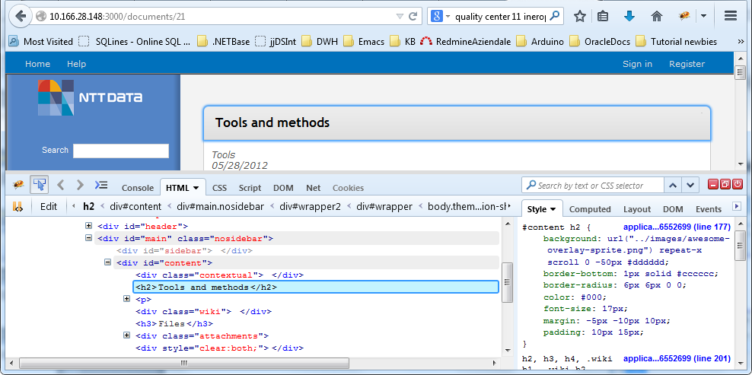
Prerequisiti
Esperienza nello sviluppo di piccole applicazioni web in HTML4 da almeno 4-5 mesi
Conoscenza dei concetti sottesi alla programmazione ad oggetti (classi, ereditarietà, polimorfismo, template)
Conoscenza minimale di C# e minima conoscenza di cosa sia un database (DB)
Conoscenza minimale di un browser web (Chrome/Firefox/Internet Explorer 10/11) e dei relativi tool di debugging integrati
Voglia di imparare!

Slide 6
Giorno 1
Presentazione e questionario di livellamento
Visual Studio / IIS installation
Hands On: Simple ASP.NET Project
Semantic HTML
Primi concetti di CSS e overview dei tool di Visual Studio 2013
Recap

Slide 7
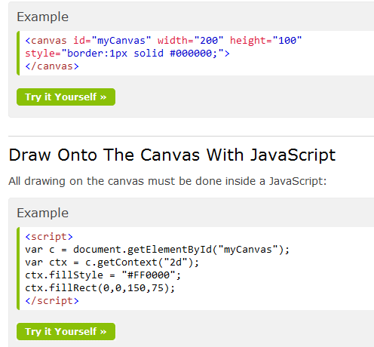
Giorno 1: Questionario di livellamento
1990
2002
1999, Asynchronous JavaScript and XML
Ultimo progetto fatto?
In che anno nasce il World Wide Web?
In che anno nasce WebForms?
Quando nasce e cosa vuol dire AJAX?
Cosa è il tag canvas…?

Slide 8
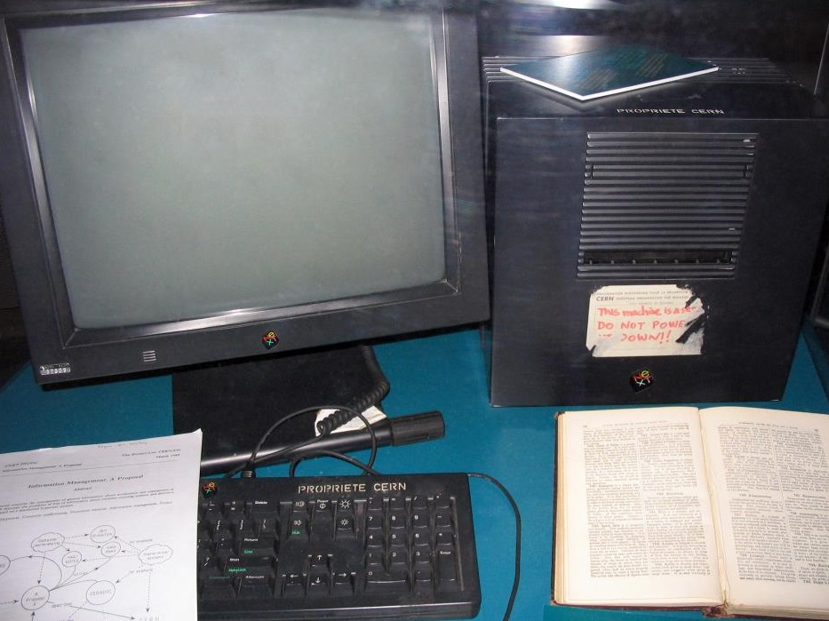
1990 The First web server…on a NeXT...

Slide 9
HTML5: Storia
In 2003, the publication of XForms, a technology which was positioned as the next generation of Web forms, sparked a renewed interest in evolving HTML
The idea that HTML's evolution should be reopened was tested at a W3C workshop in 2004, where some of the principles that underlie the HTML5 work […] as well as the aforementioned early draft proposal covering just forms-related features, were presented to the W3C jointly by Mozilla and Opera. The proposal was rejected on the grounds that the proposal conflicted with the previously chosen direction for the Web's evolution; the W3C staff and membership voted to continue developing XML-based replacements instead.
Shortly thereafter, Apple, Mozilla, and Opera jointly announced their intent to continue working on the effort under the umbrella of a new venue called the WHATWG (Web Hypertext Application Technology Working Group)
In 2006, the W3C indicated an interest to participate in the development of HTML5 after all, and in 2007 formed a working group chartered to work with the WHATWG on the development of the HTML5 specification[…]
In mid 2012, a new editing team was introduced at the W3C to take care of creating a HTML5 Recommendation and prepare a Working Draft for the next HTML version.

Slide 10
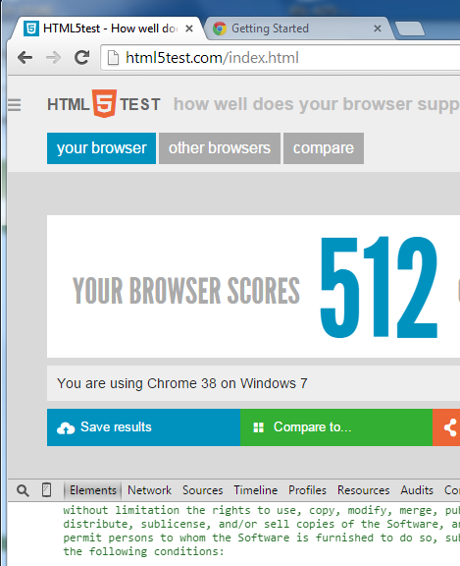
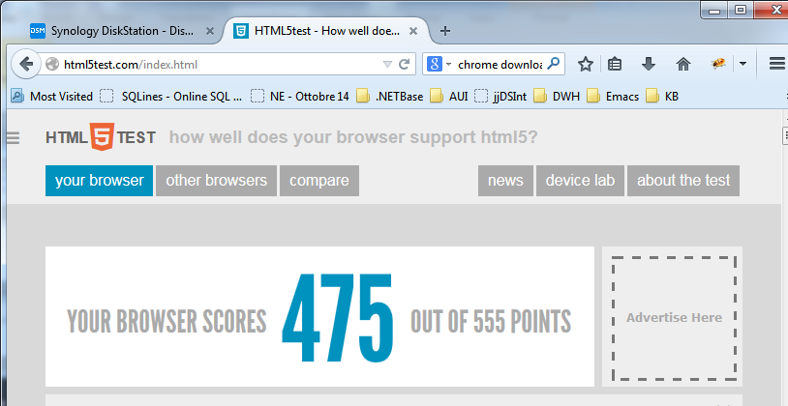
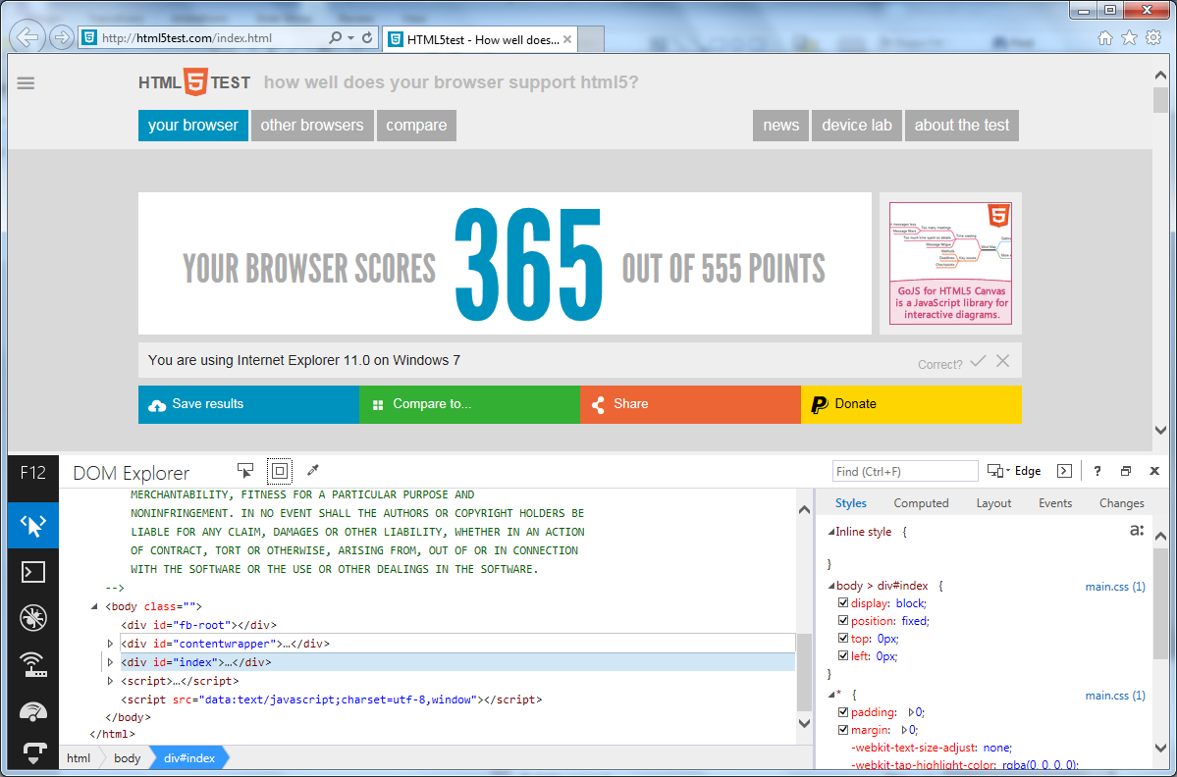
HTML5: Browser Status
Is your browser ready?... http://html5test.com/index.html
F12 Developer tools on IE11 / Chrome / Firefox

Slide 11
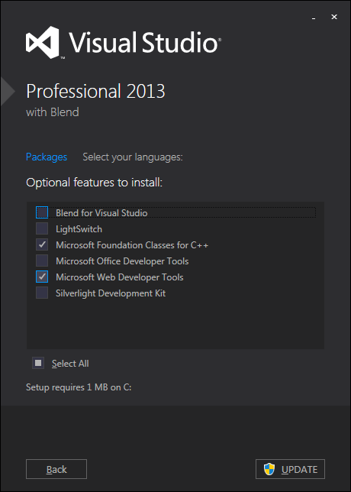
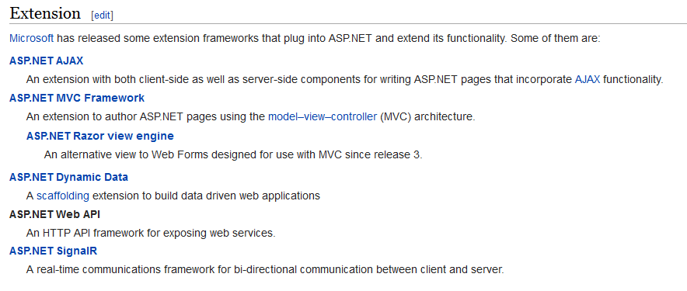
Technology overview
Notes:
Elenco delle tecnologie aggiuntive oltre web forms

Slide 12
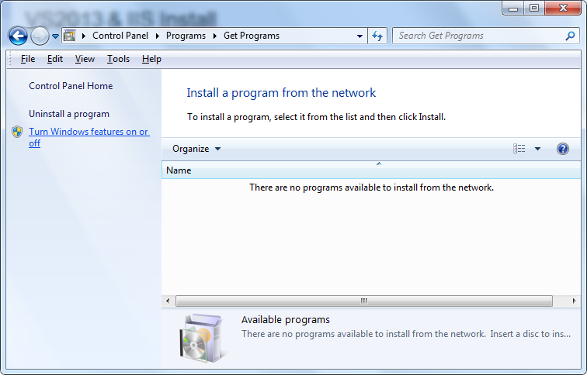
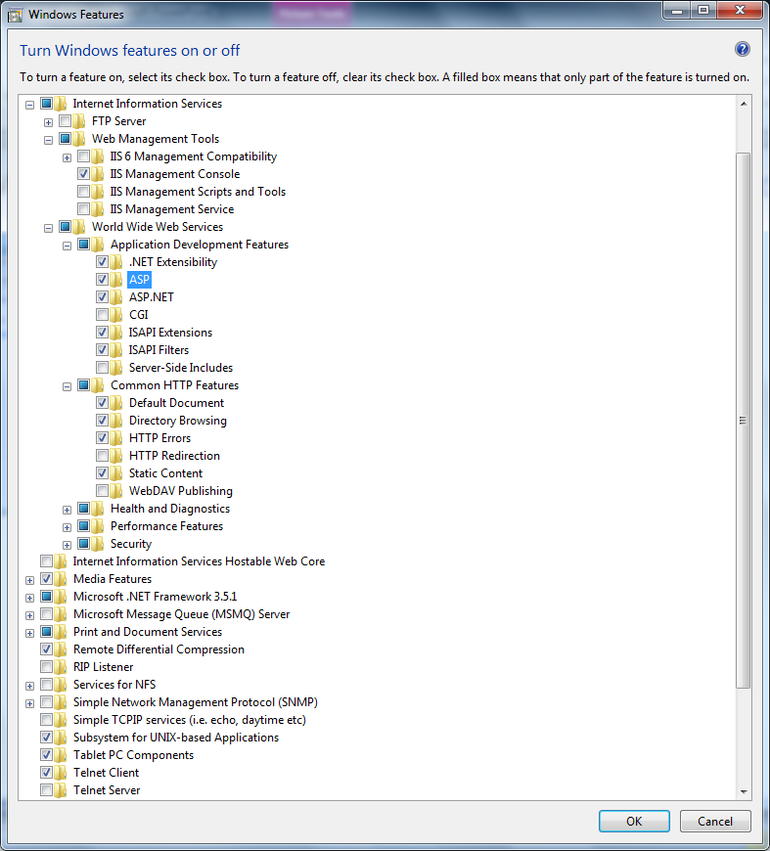
VS2013 & IIS Install

Slide 13
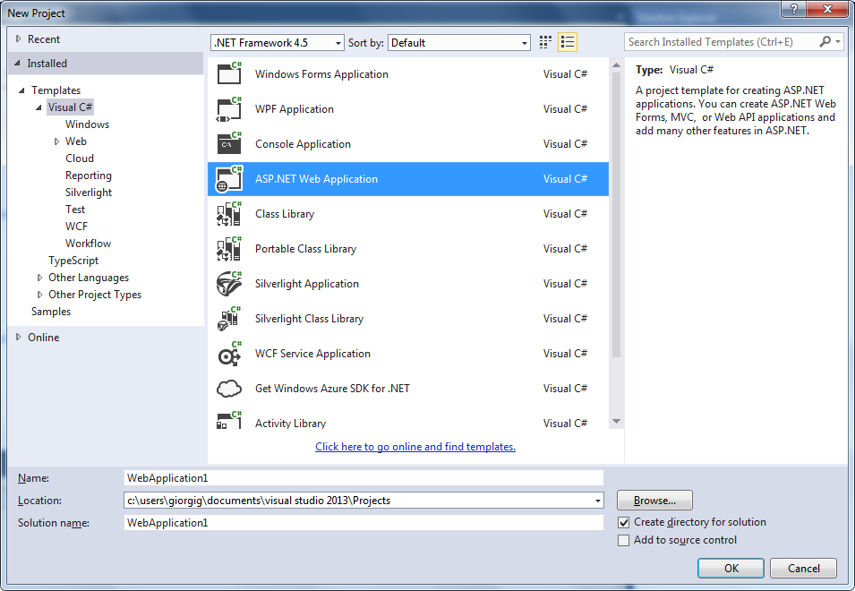
Visual Studio 2013 Hands on!

Slide 14
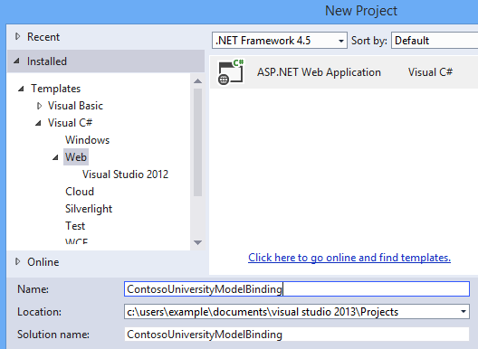
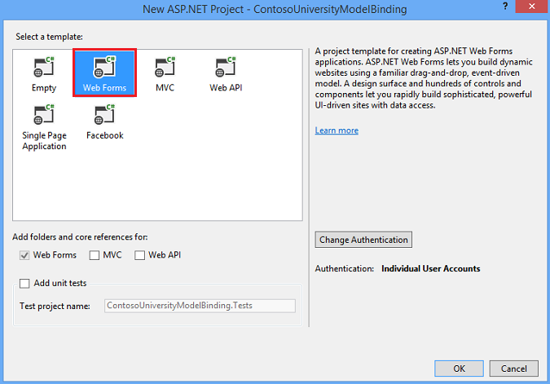
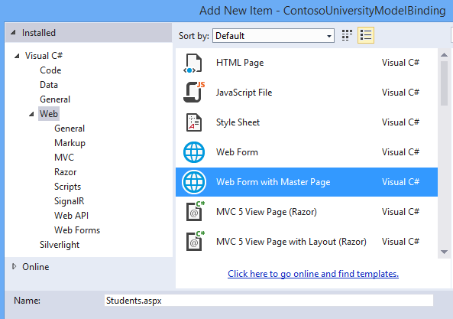
WebForms

Slide 15
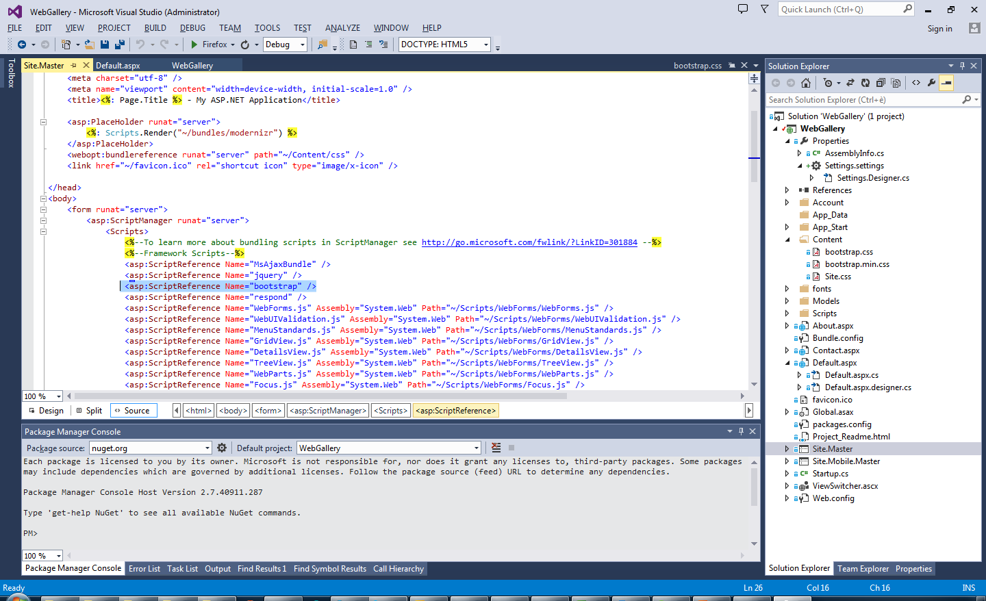
Site Master e TwitterBootstrap
Notes:
Dove si mostra l’aderenza agli standard html5 e si introduce il concetto di SiteMaster
Si modifica il titolo della webapp e si prende famigliarità con i concetti di base dell editing on the fly dell’html
Guardare anche http://www.asp.net/visual-studio/overview/2013/creating-web-projects-in-visual-studio#bootstrap
per capire cosa è html5

Slide 16
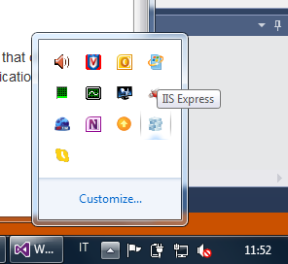
Step1: Conosciamo IIS Express
Notes:
IIS Express: il web giocattolo

Slide 17
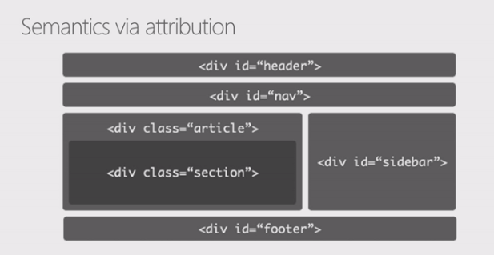
Semantic Html5

Slide 18
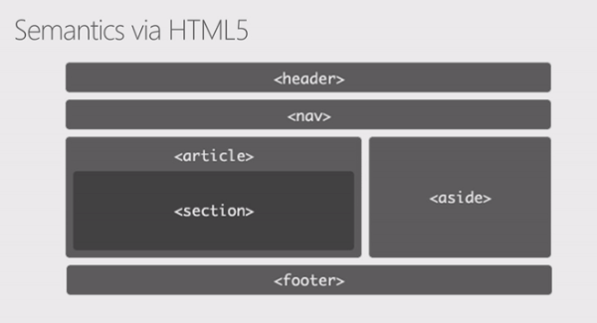
Semantic Html5

Slide 19
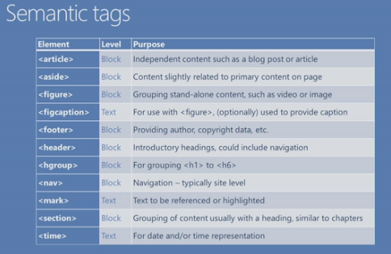
Semantic Html5

Slide 20
Form Validation
Old style, javascript (jquery.validate.js).
HTML5: funzionalità native che consentono di affidarsi unicamente al markup, senza dove ricorrere a js o a plugin esterni.
Nuovi type per l’input element: email, number, range, search, tel, url e di diversi nuovi attributi come placeholder, autofocus, required, min, max, etc.
Notes:
Vedi html5-intro.html

Slide 21
Microdati
http://www.w3.org/TR/microdata/ This specification defines the HTML microdata mechanism. This mechanism allows machine-readable data to be embedded in HTML documents in an easy-to-write manner, with an unambiguous parsing model. It is compatible with numerous other data formats including RDF and JSON.
Sometimes, it is desirable to annotate content with specific machine-readable labels, e.g. to allow generic scripts to provide services that are customised to the page, or to enable content from a variety of cooperating authors to be processed by a single script in a consistent manner.
For this purpose, authors can use the microdata features described in this section. Microdata allows nested groups of name-value pairs to be added to documents, in parallel with the existing content.

Slide 22
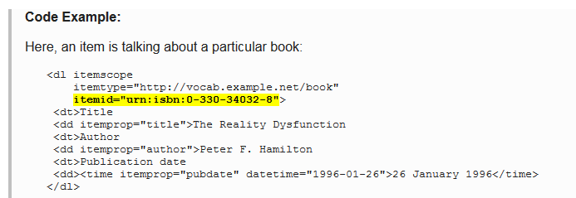
Microdati
Es di schema http://schema.org/Book
Full list item types: http://schema.org/docs/full.html
Rich Snippet http://www.google.com/webmasters/tools/richsnippets

Slide 23
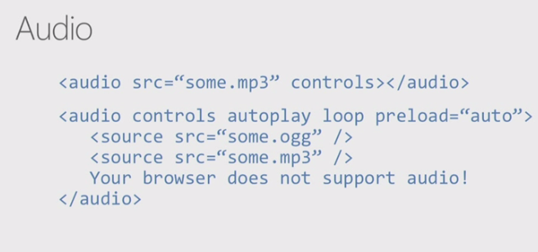
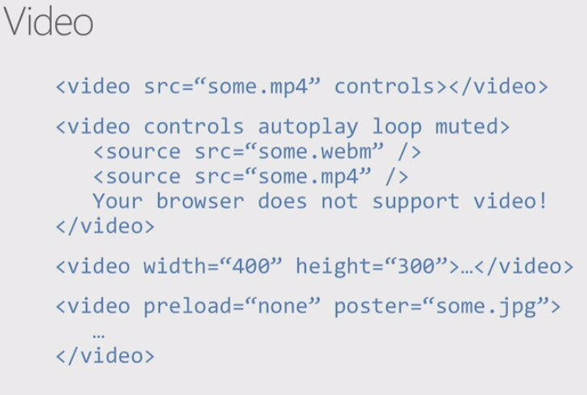
Audio & Video tags

Slide 24
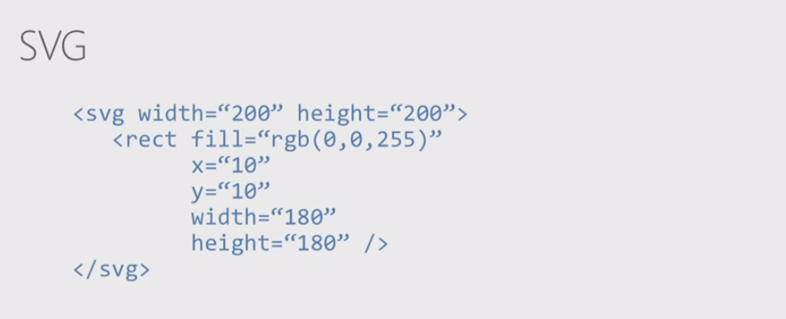
SVG

Slide 25
For day 2
CSS3 in azione: https://github.com/mrdoob/three.js
jQuery Lab Selector http://www.bibeault.org/jqueryinaction/chapter2/lab.selectors.html
Showcases
http://taitems.github.io/UX-Lab/
http://cssdeck.com/labs/fancy-3d-button
http://css-tricks.com/3d-button-parallax/
http://cssdeck.com

